Slide 1
Introduction to
Electronics
Lecture 5 : Sensors
1

Slide 2
Learning Objectives
Understand the role of sensors in converting physical properties to electrical signals
Distinguish between precision, accuracy, and resolution in sensor measurements
Explain the principles and importance of sensor calibration
Compare temperature sensor types: thermistors, thermocouples, RTDs, and IC sensors
Describe proximity and touch sensing technologies including resistive touch screens
Identify common sensors for motion, chemical detection, light, and GPS positioning
2

Slide 3
PART 1
General Principles of Sensing
Fundamental concepts that underpin all sensor systems
3

Slide 4
What Are Sensors?
Sensors are devices that measure a physical property such as temperature, humidity, or stress
In electronics, the goal is to convert these measurements into electrical signals
Some sensors provide an analog output — a voltage proportional to the measured property
Others are digital devices that transmit data about the property directly
In both cases, sensor readings are often the input to a microcontroller
The definition stretches to include systems like GPS that locate position in space
4

Slide 5
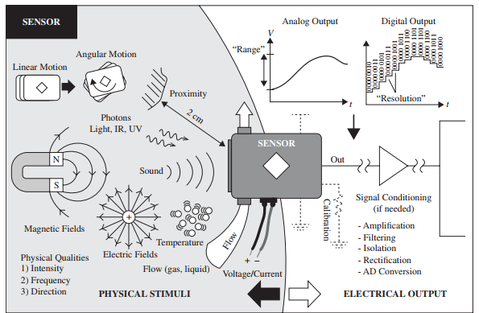
Sensor Overview — Physical Stimuli to Electrical Output
5

Slide 6
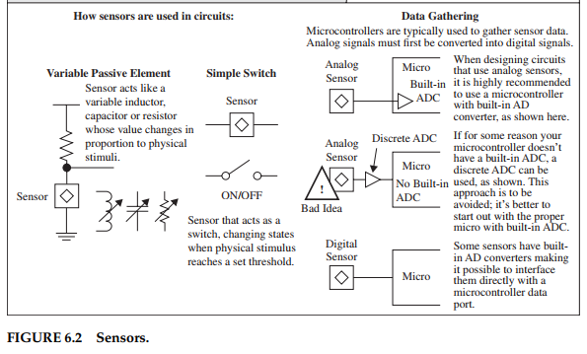
How Sensors Are Used in Circuits (Fig. 6.2)
6
FIGURE 6.2

Slide 7
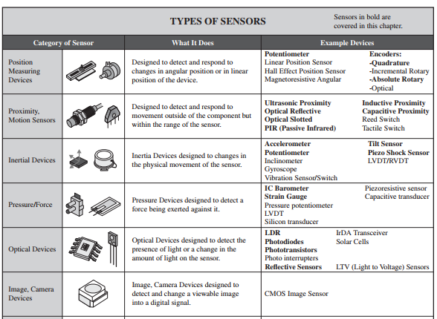
Types of Sensors (Fig. 6.1)
7
FIGURE 6.1

Slide 8
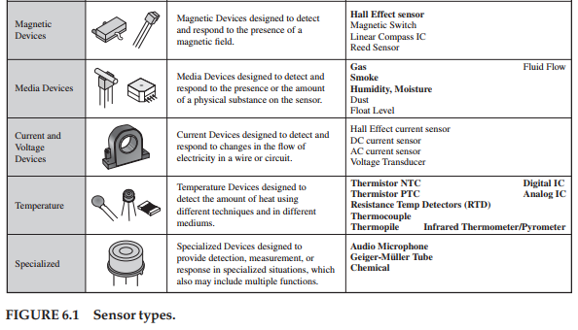
Types of Sensors (Fig. 6.1 continued)
8
FIGURE 6.1 (continued)

Slide 9
Precision, Accuracy, and Resolution
Precision — the number of digits (or bits) reported by the sensor
Accuracy — how close the reading is to the true value
A sensor can be very precise but inaccurate (e.g., scales showing 85.7 kg when true weight is 92.1 kg)
Resolution — the finest increment the sensor can distinguish
Digital: 8 bits = 1 in 256, 12 bits = 1 in 4096
Analog: readings are continuous but limited by instrument markings
High precision does not guarantee high accuracy — calibration bridges the gap
9

Slide 10
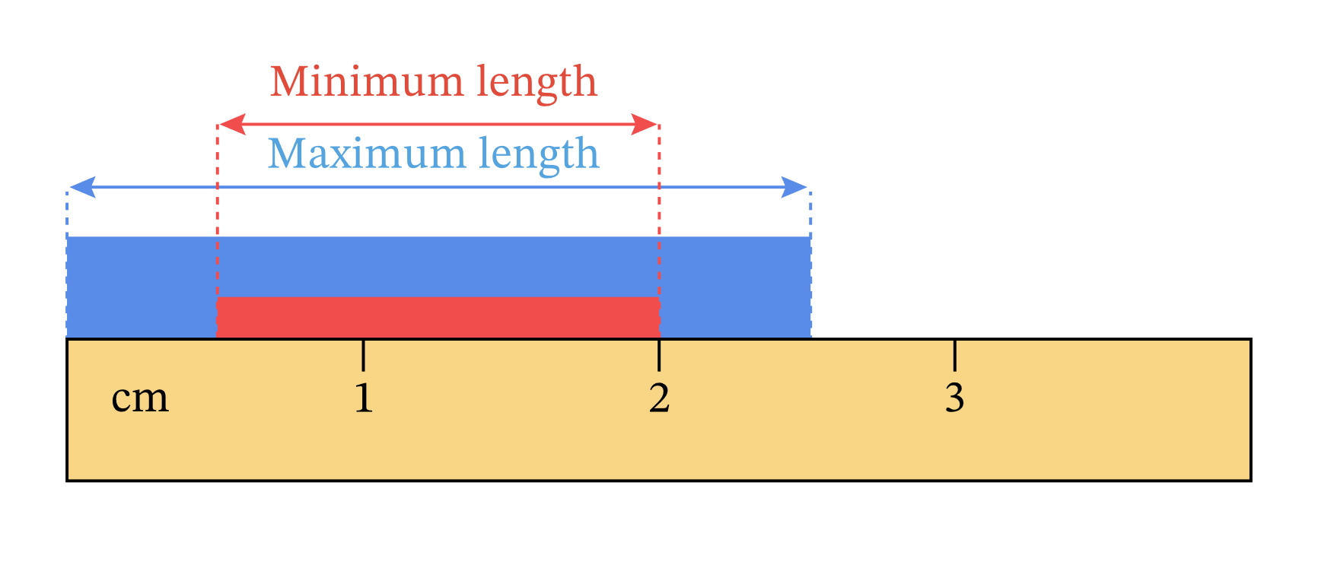
Resolution Example — Ruler with 1 cm Resolution
10

Slide 11
The Observer Effect
The act of observing a property can change it
Example: measuring tyre pressure with a conventional gauge releases a small amount of air
For most sensors, this change has a negligible effect on the reading
Worth keeping in mind when deciding whether a measurement reflects the true value
Electronic sensors generally minimise the observer effect through high-impedance inputs
11

Slide 12
Calibration
Calibration compares sensor readings against a known, accurate standard
Example: calibrating a temperature sensor with boiling distilled water at 100°C
Deviations are compensated using lookup tables: raw ADC values mapped to true values
Interpolation between table entries assumes small, locally linear segments
Some IC sensors are individually calibrated during manufacture, with values stored in ROM
Mass-produced consumer items often skip individual calibration to reduce cost
Specialised, high-value equipment typically requires per-unit calibration
12

Slide 13
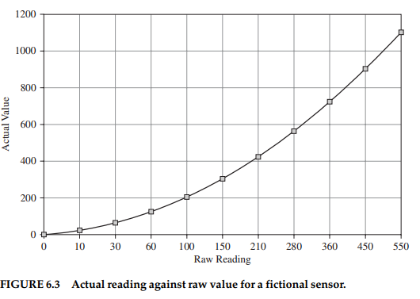
Calibration Curve (Fig. 6.3)
13
FIGURE 6.3 — Actual reading vs. raw value for a fictional sensor

Slide 14
PART 2
Temperature Sensors
Thermistors, thermocouples, and IC-based solutions
14

Slide 15
Temperature Sensors — Overview
One of the most common types of sensors in electronics
Computers and equipment sense their own temperature to prevent overheating
Thermostats keep temperature constant by controlling power to a load (on/off switching)
Main sensor families: thermistors, thermocouples, resistive temperature detectors(RTDs), analog ICs, digital ICs, and infrared
Choice depends on required range, accuracy, cost, and interface complexity
15

Slide 16
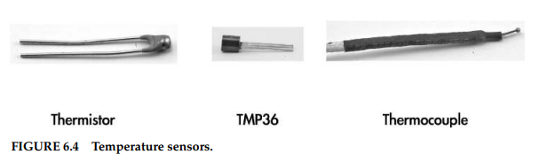
Temperature Sensor Types (Fig. 6.4)
FIGURE 6.4 — Temperature sensors
16

Slide 17
Thermistors — NTC and PTC
“Thermistor” = thermal + resistor: a resistor whose value changes markedly with temperature
NTC (Negative Temperature Coefficient) — resistance decreases as temperature increases
PTC (Positive Temperature Coefficient) — resistance increases as temperature increases
NTC is the more common type in practice
The resistance–temperature relationship is highly non-linear
Even over 0–100°C, a linear approximation introduces considerable errors
17

Slide 18
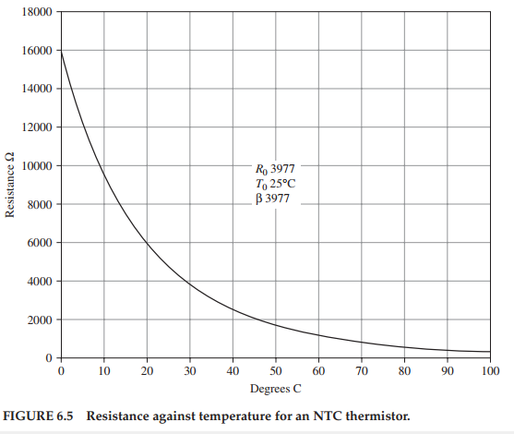
NTC Thermistor Curve (Fig. 6.5)
18
FIGURE 6.5 — Resistance vs. temperature for an NTC thermistor

Slide 19

Modelling Thermistor Behaviour
The Steinhart-Hart equation is used to determine the temperature as a function of the thermistor’s resistance.
It works for both NTC and PTC devices
where T is temperature in Kelvin; R is resistance in ohms
A, B, and C are constants specific to the thermistor (from manufacturer)
The manufacturer of the thermistor will supply the constant values in a data sheet
19

Slide 20

Beta Parameter Model (Eq. 6.2)
An alternative model using a single Beta parameter and reference values T₀ and R₀:
T₀ is usually 25°C (298.15 K); R₀ is the resistance at T₀
Beta (β) is a single constant provided by the manufacturer
Simpler than Steinhart-Hart but less accurate over wide ranges
Widely used in practical thermistor circuits due to its simplicity
20

Slide 21
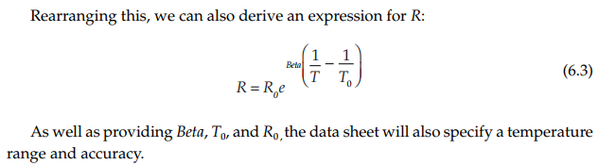
Deriving Resistance from Temperature (Eq. 6.3)
Rearranging the Beta equation gives resistance R as a function of temperature T
Useful for calculating expected resistance at a given temperature
The manufacturer’s data sheet provides Beta, T₀, R₀, plus the valid temperature range
Allows verification of thermistor readings against expected values
21

Slide 22
Using a Thermistor as a Thermometer
A voltage divider converts the thermistor’s resistance change into a measurable voltage
Fixed resistor R₁ is chosen equal to R₀ (resistance at 25°C)
Output voltage Vout is fed to the microcontroller’s ADC input
As temperature rises, NTC resistance drops → V_out changes proportionally
The ADC converts the analog voltage into a digital value for software processing
Software then applies the Steinhart-Hart or Beta equation to compute temperature
22

Slide 23
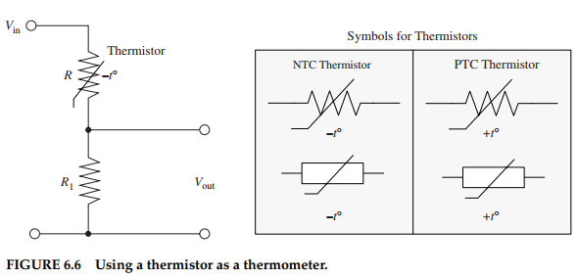
Thermistor Circuit and Symbols (Fig. 6.6)
FIGURE 6.6 — Using a thermistor as a thermometer
23

Slide 24
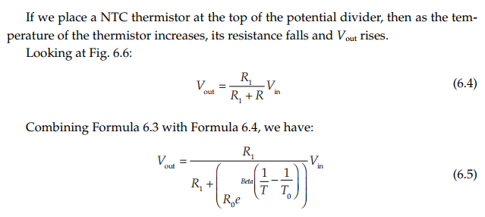
Thermistor Voltage Divider — Detail
24

Slide 25
Thermocouples
Used for much higher temperatures and wider ranges than thermistors (–200 to +1350°C)
Based on the Seebeck effect: a conductor in a thermal gradient generates a small voltage
Two different metals are joined; the junction temperature is measured via the voltage across the leads
A “cold-junction” temperature at the far end must also be measured (often with a thermistor)
Lookup tables convert the voltage and cold-junction temperature to absolute temperature
Most common alloys: chromel (90% Ni, 10% Cr) and alumel (95% Ni, 2% Mn, 2% Al, 1% Si)
Sensitivity: approximately 41 µV/°C
25

Slide 26
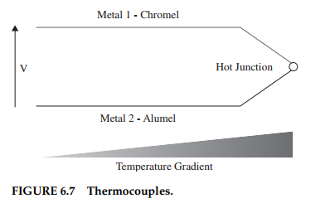
Thermocouple Principle (Fig. 6.7)
26
FIGURE 6.7 — Thermocouples

Slide 27
Other Temperature Sensors
Resistive Temperature Detectors (RTDs) — accurate, good linearity, but expensive and slow
Analog Output Thermometer ICs (e.g., TMP36) — simple to interface, ±2°C accuracy
Digital Thermometer ICs (e.g., DS18B20) — easy for microcontrollers, ±0.5°C accuracy
Infrared Thermometers / Pyrometers — non-contact measurement, ±0.5°C, up to 1030°C
Choice depends on temperature range, accuracy needs, cost, and interface requirements
27

Slide 28
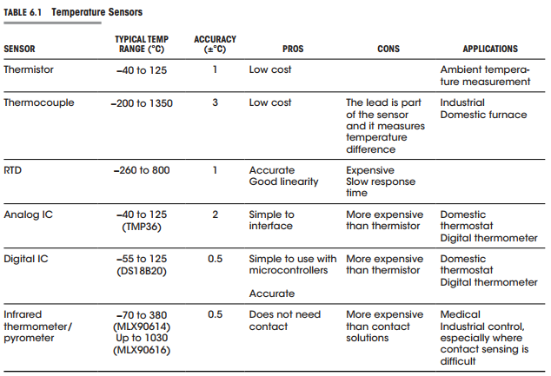
Temperature Sensor Comparison (Table 6.1)
28

Slide 29
PART 3
Proximity and Touch
Detecting objects and measuring distance
29

Slide 30
Proximity and Touch — Overview
This category covers detecting objects or measuring their distance from the sensor
Technologies include touch screens, ultrasonic rangefinders, and Infrared (IR) proximity sensors
Touch screens are widely used in phones and tablets
Ultrasonic sensors measure distance using the time-of-flight of a sound wave
Optical sensors use infrared light reflection to detect nearby objects
Capacitive sensors detect proximity through changes in the electric field
30

Slide 31
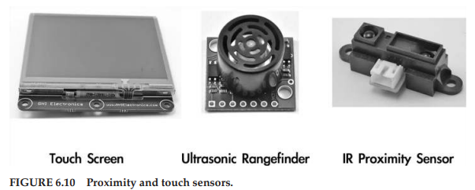
Proximity and Touch Sensors (Fig. 6.10)
31

Slide 32
Resistive Touch Screens
One of the older and more readily available touch screen technologies
A flexible, transparent conductive sheet sits on top of the display
Both top and bottom surfaces are coated with a conductive layer
Insulating micro-dots keep layers apart until pressed together
When pressed, the layers make contact, forming a voltage divider
The conductive layer acts like a potentiometer, with the touch point as the wiper
32

Slide 33
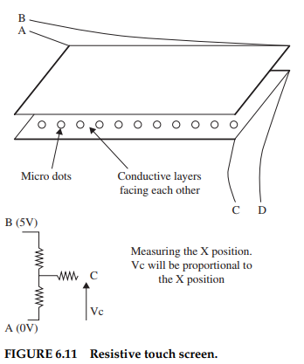
Resistive Touch Screen (Fig. 6.11)
33
FIGURE 6.11 — Resistive touch screen

Slide 34
Touch Screen Position Measurement
Measuring X: set A = 0 V and B = 5 V; voltage at C is proportional to the X position
Measuring Y: swap — set C = 0 V and D = 5 V; voltage at A or B gives the Y position
The ADC converts each voltage to a coordinate pair (X, Y)
The measuring device must have high input impedance (≈ several MΩ) to avoid errors
All processing is handled by a special-purpose controller chip or microcontroller
Rapid switching between X and Y readings gives responsive touch tracking
34

Slide 35
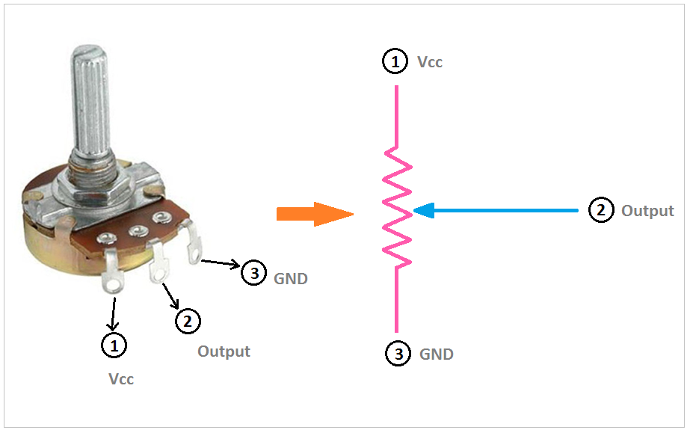
Potentiometer Analogy for Touch Screens
The conductive layer of a resistive touch screen acts as a potentiometer
The touch point serves as the wiper, producing a voltage proportional to position
35

Slide 36
Ultrasonic Distance Measurement
An ultrasonic sender emits a burst of high-frequency sound pulses
Pulses bounce off the target and return to the receiver
Distance is calculated from the round-trip time of the sound pulse
d = (speed of sound × time) / 2
Typical range: a few centimetres to several metres
Widely used in robotics, parking sensors, and level measurement
36

Slide 37
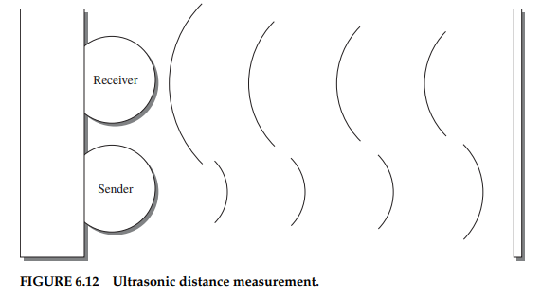
Ultrasonic Distance Measurement (Fig. 6.12)
FIGURE 6.12 — Ultrasonic distance measurement
37

Slide 38
Optical Distance Measurement
An infrared (IR) LED emits infrared light towards the target
An IR sensor detects the reflected light from the obstacle
The angle or intensity of the reflected beam indicates the distance
Control electronics process the sensor signal and output a voltage or digital reading
Common in consumer electronics, robotics, and industrial automation
Effective range typically a few centimetres to about one metre
38

Slide 39
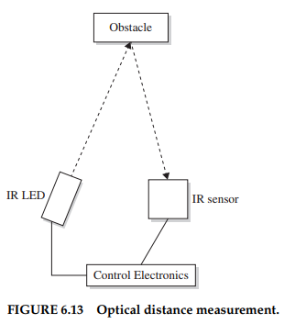
Optical Distance Measurement (Fig. 6.13)
39
FIGURE 6.13 — Optical distance measurement

Slide 40
Capacitive Sensors
A conductive plate (electrode) is connected to a microcontroller through a large resistor
The microcontroller sends a pulse on the “Send” pin and measures the time to charge on “Receive”
When a hand (or conductive object) approaches, it adds capacitance to the plate
Increased capacitance increases the RC time constant, changing the charge time
The microcontroller detects this change and interprets it as proximity or touch
Used in touch buttons, proximity switches, and touchless interfaces
40

Slide 41
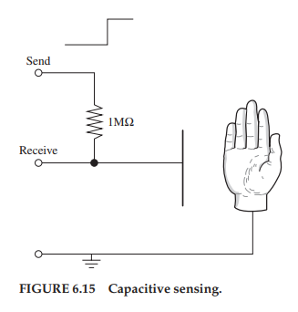
Capacitive Sensing (Fig. 6.15)
41
FIGURE 6.15 — Capacitive sensing

Slide 42
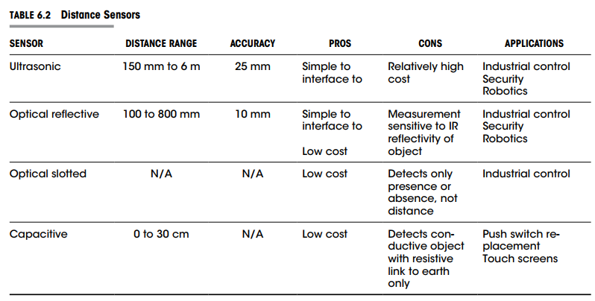
Distance Sensor Comparison (Table 6.2)
42
TABLE 6.2 — Comparing distance sensors

Slide 43
PART 4
Movement, Force, and Pressure
Detecting physical motion and mechanical forces
43

Slide 44
Movement, Force, and Pressure
Many sensors detect how things are moving, bending, or being compressed
Accelerometers — detect orientation and acceleration (used in smartphones for screen rotation)
Gyroscopes — measure angular velocity and rotation
Strain gauges — detect deformation in materials under stress
Pressure sensors — measure gas or liquid pressure (e.g., barometers, tyre monitors)
Tilt and vibration sensors — detect inclination and mechanical shock
Force sensors — measure applied force for scales, robotics, and industrial applications
44

Slide 45
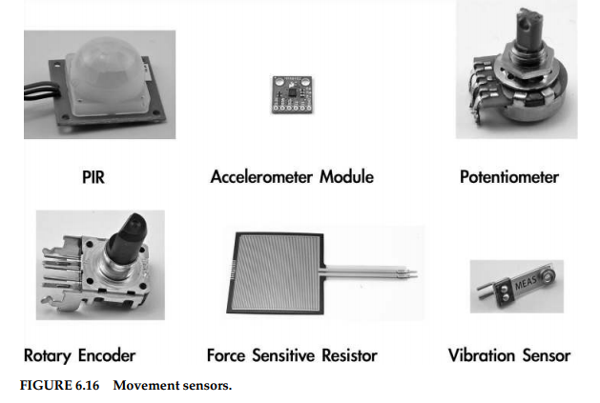
Movement and Force Sensors (Fig. 6.16)
45
FIGURE 6.16 — Movement-detecting devices

Slide 46
PART 5
Chemical Sensors
Detecting gases, smoke, and humidity
46

Slide 47
Chemical Sensors
A wide range of sensors exist for detecting chemicals of various kinds
Smoke detectors — ionisation or photoelectric types for fire safety
Gas sensors — detect specific gases (CO, CO₂, methane, LPG) using heated metal-oxide elements
Humidity sensors — measure relative humidity using capacitive or resistive sensing elements
Many chemical sensors work by changing their electrical resistance in the presence of the target substance
Output is typically an analog voltage that can be read by a microcontroller’s ADC
47

Slide 48
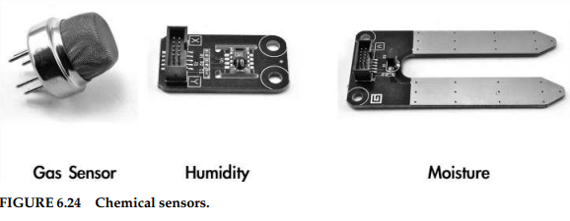
Chemical Sensors (Fig. 6.24)
FIGURE 6.24 — Chemical sensors
48

Slide 49
PART 6
Light, Radiation, Magnetism,
Sound, and GPS
Detecting electromagnetic and acoustic phenomena
49

Slide 50
Light, Radiation, Magnetism, and Sound
Light sensors — light-dependent resistors (LDRs), photodiodes, and phototransistors detect light intensity
Ionising radiation — Geiger-Müller tubes detect radioactive emissions
Magnetic field sensors — Hall effect sensors and reed switches detect magnetic fields
Sound sensors — microphones (electret, mirco-electro mechanical systems (MEMS)) convert sound waves to electrical signals
Many of these sensors are analog, requiring ADC conversion for microcontroller use
Some include built-in signal conditioning or digital interfaces
50

Slide 51
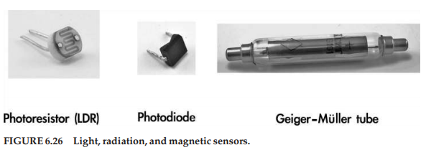
Light, Radiation, and Magnetic Sensors (Fig. 6.26)
FIGURE 6.26 — Various sensors
51

Slide 52
Global Positioning System (GPS)
GPS modules are readily available at low cost due to consumer device demand
A constellation of satellites broadcasts highly accurate, synchronised time signals
A GPS receiver measures the time difference between signals from multiple satellites
The differences (due to signal travel time) are used to triangulate the receiver’s position
GPS modules are typically a single IC with a dedicated antenna
Serial interface transmits position updates, time, and satellite count to a microcontroller
52

Slide 53
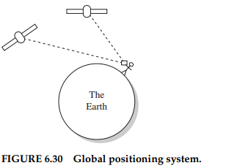
GPS Satellite Constellation (Fig. 6.30)
53

Slide 54
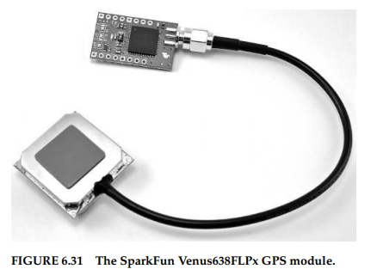
GPS Module (Fig. 6.31)
54
FIGURE 6.31 — Venus 638 FLPx GPS module with antenna

Slide 55
End of Lecture
Questions?
55

